Slide 1
PokerFace: a Privacy-Preserving Facial Recognition System via Lattice-Based Fuzzy Extractors
郁昱
July 2021

Slide 2
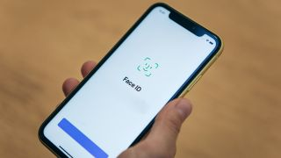
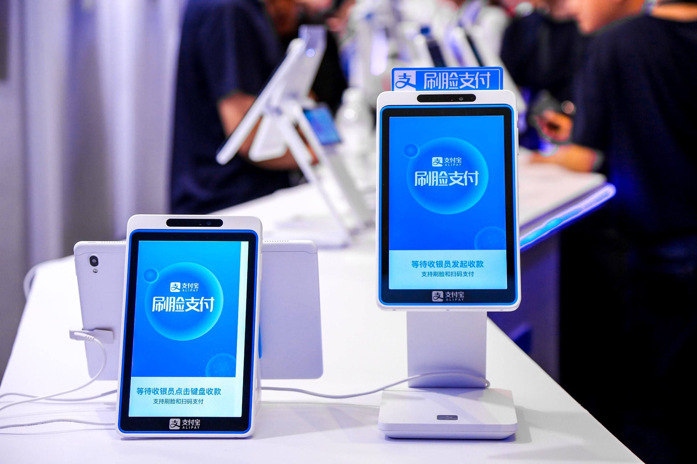
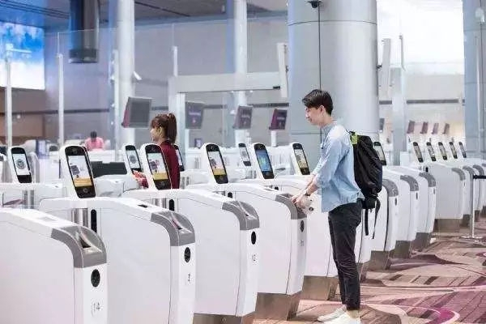
Facial Recognition
Facial recognition is a part of our modern life.
Unlock mobile phone
Pay in face
Entrance control

Slide 3
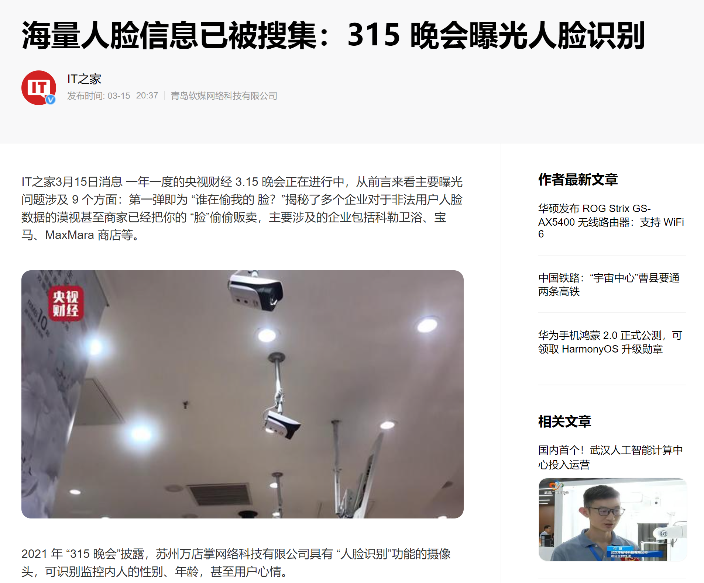


Privacy and Security Concern

Slide 4
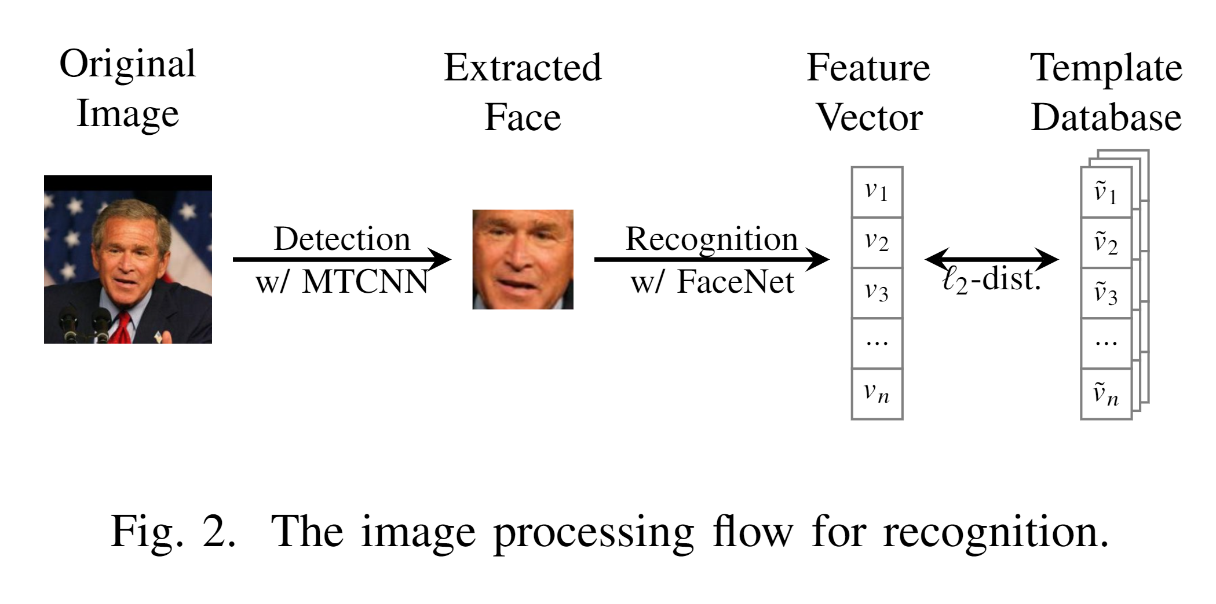
Facial Recognition Workflow

Slide 5
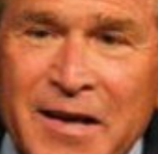
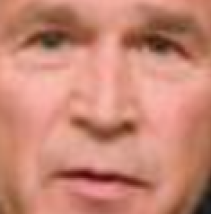
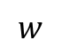
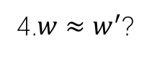
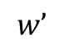
Facial Recognition Workflow
Model
3.
$$w$$
$$w’$$
Cloud
4.$w≈w^{′}$?
1.
2.
User
IoT device

Slide 6

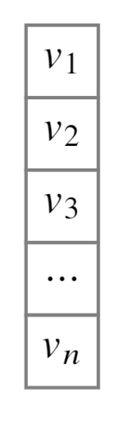


How do we store biometric templates?
Plaintext !
Cloud Server:
Encrypt but decrypt when use
Mobile Phone:
TEE or Nothing
BUT it is a real vector, NOT image…
Secure?
Cloud/Phone

Slide 7
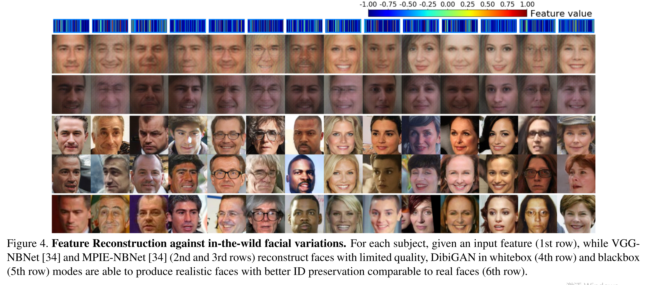
Vec2Face: Unveil Human Faces from their Blackbox Features in Face Recognition [CVPR2020]

Slide 8
How do we store biometric templates?
Feature vector is not secure
Can we protect them?
Yes. This is our work.

Slide 9
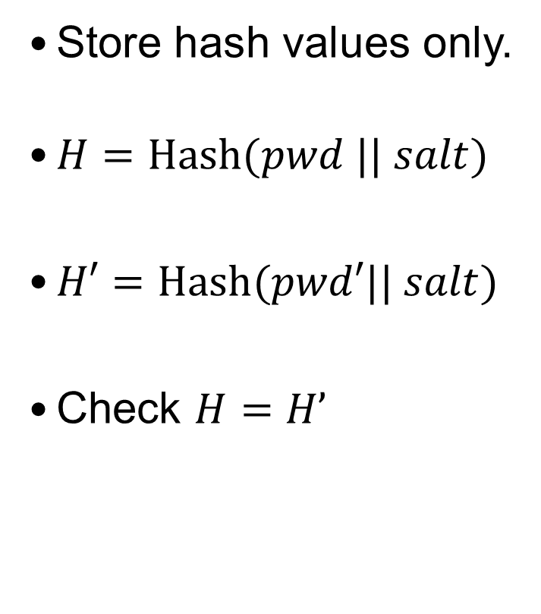
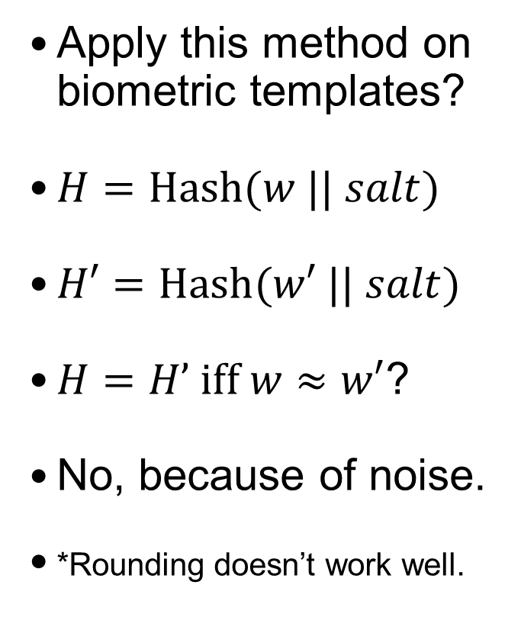
Review: How do we protect passwords?
Store hash values only.
$H=Hash(pwd || salt)$
$H′=Hash(pwd′|| salt)$
Check $H=H’$
Apply this method on biometric templates?
$H=Hash(w || salt)$
$H′=Hash(w′ || salt)$
$H=H’ iff w≈w′$?
No, because of noise.
*Rounding doesn’t work well.
Cloud/Phone
Hash values

Slide 10
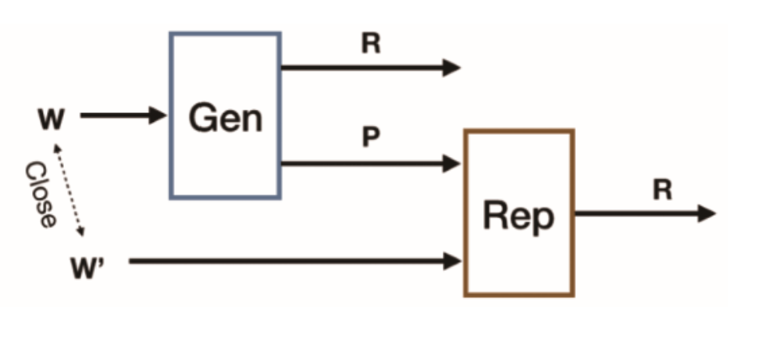
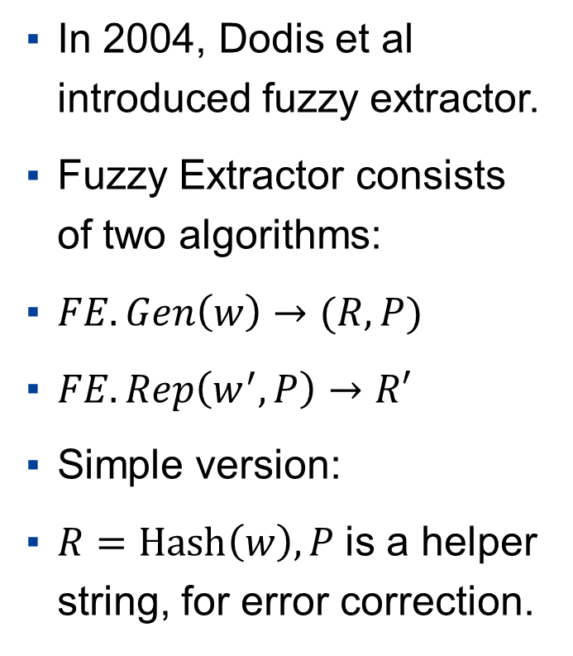
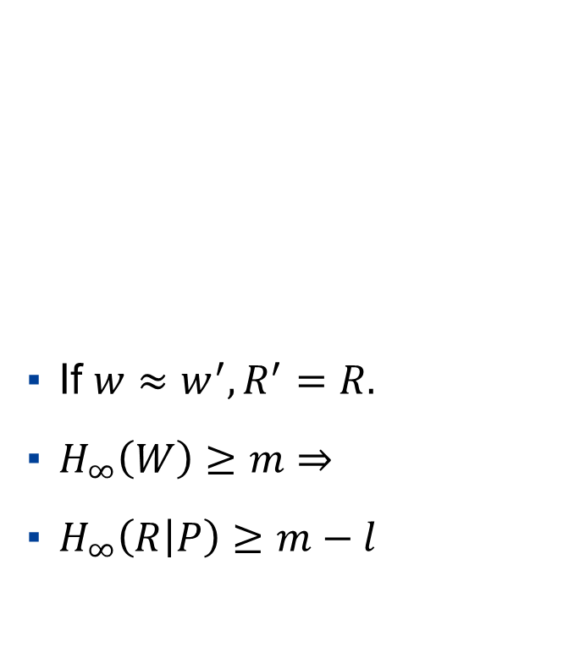
Fuzzy Extractor
In 2004, Dodis et al introduced fuzzy extractor.
Fuzzy Extractor consists of two algorithms:
$FE.Gen\left(w\right)→(R,P)$
$FE.Rep\left(w^{′},P\right)→R′$
Simple version:
$R=Hash\left(w\right),P$is a helper string, for error correction.
If $w≈w^{′},R^{′}=R.$
$H_{∞}\left(W\right)≥m⇒$
$H_{∞}\left(R | P\right)≥m−l$

Slide 11
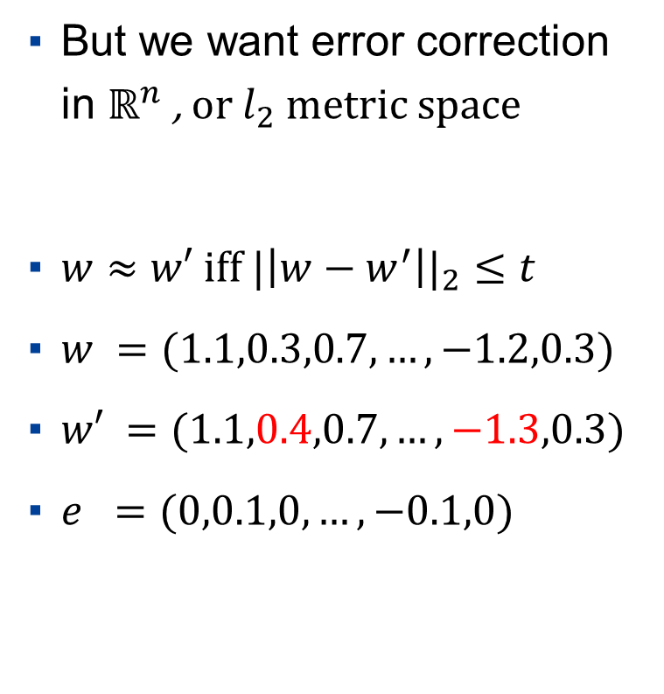
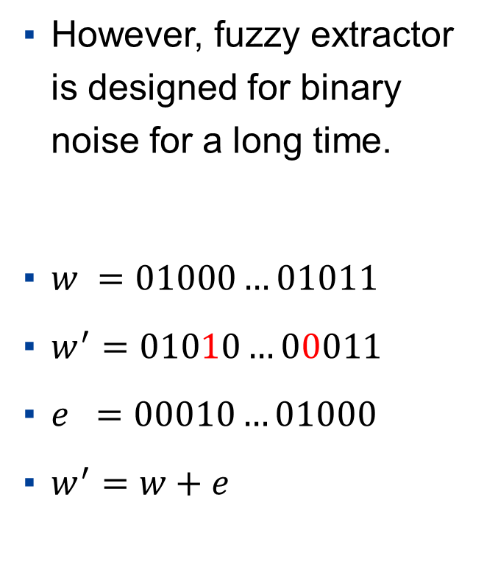
Fuzzy Extractor
However, fuzzy extractor is designed for binary noise for a long time.
$w =01000…01011$
$w^{′}=01010…00011$
$e =00010…01000$
$w^{′}=w+e$
But we want error correction in $ℝ^{n}$ , or $l_{2}$ metric space
$w≈w′ iff |{\left|w−w^{′}\right||}_{2}≤t$
$w =(1.1,0.3,0.7,…,−1.2,0.3)$
$w′ =(1.1,0.4,0.7,…,−1.3,0.3)$
$e =(0,0.1,0,…,−0.1,0)$

Slide 12
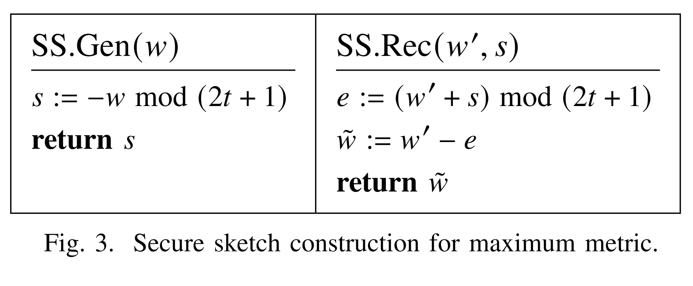
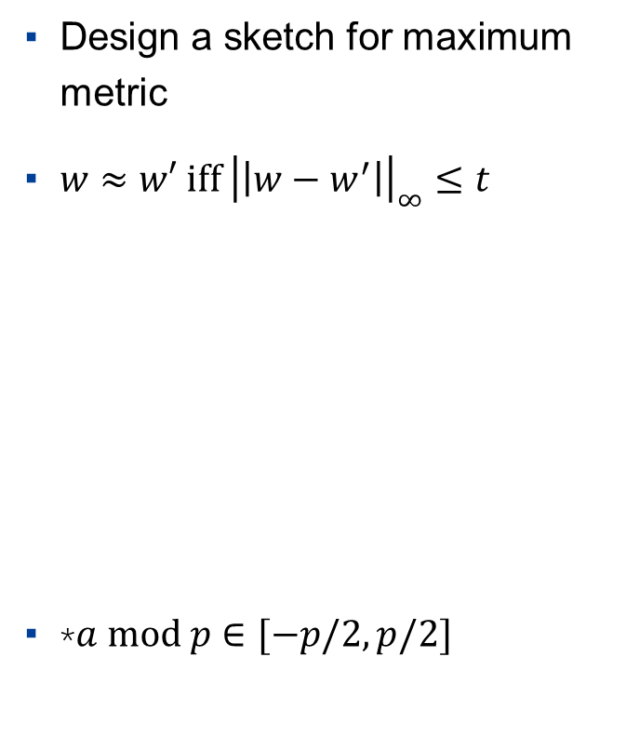
Lattice based Fuzzy Extractor - $l_{∞}$
We call the syndrome in fuzzy extractor “sketch”.
w.l.o.g. assume real numbers are represented in scaled integers.
Design a sketch for maximum metric
$w≈w′ iff {\left|\left|w−w^{′}\right|\right|}_{∞}≤t$
*$a mod p$ $∈[−p/2,p/2]$

Slide 13
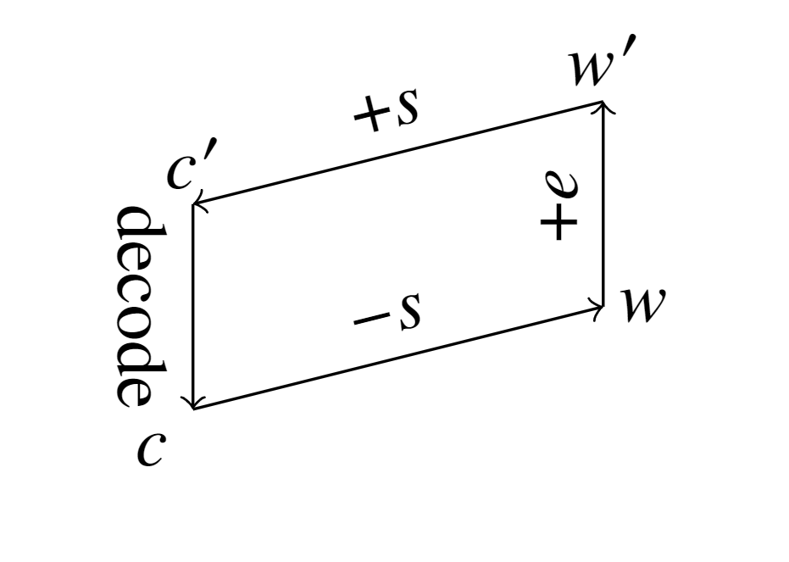
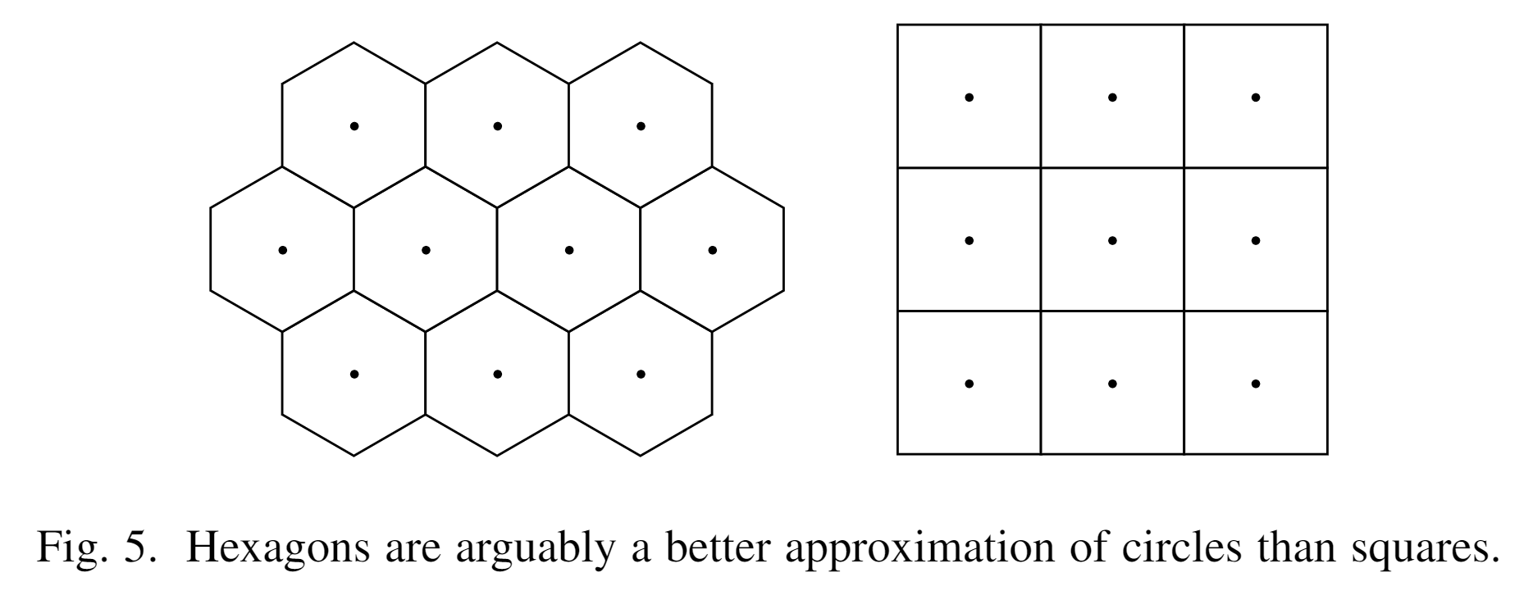
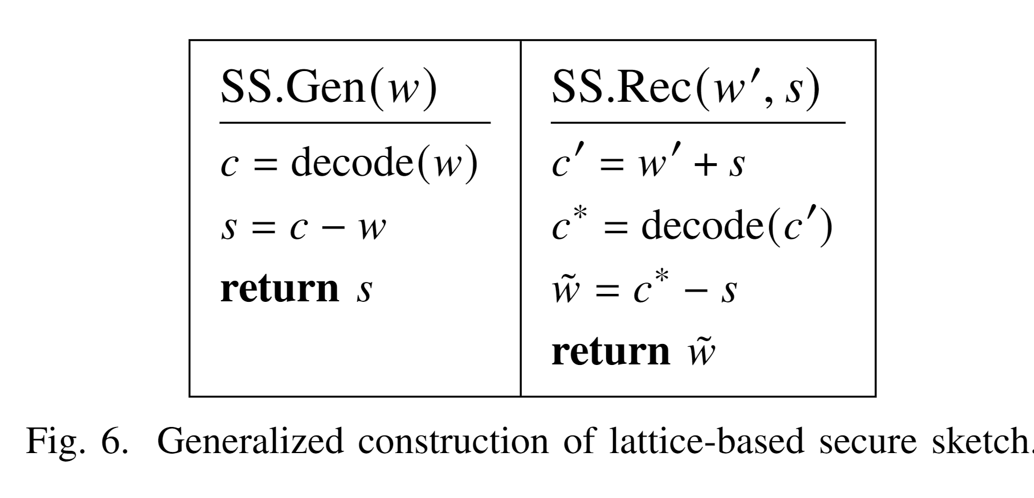
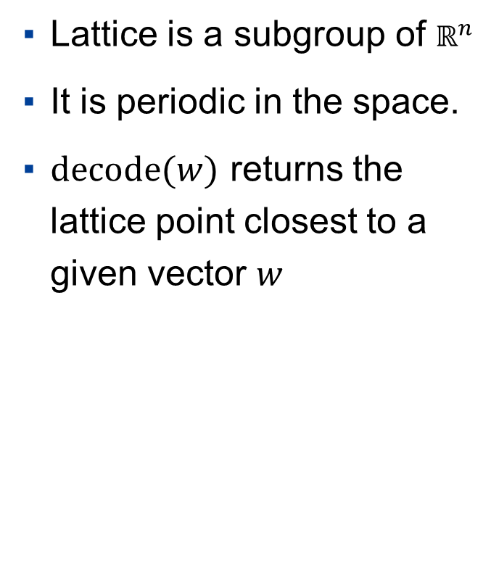
Lattice based Fuzzy Extractor - Generalized
Lattice is a subgroup of $ℝ^{n}$
It is periodic in the space.
$decode(w)$ returns the lattice point closest to a given vector $w$

Slide 14
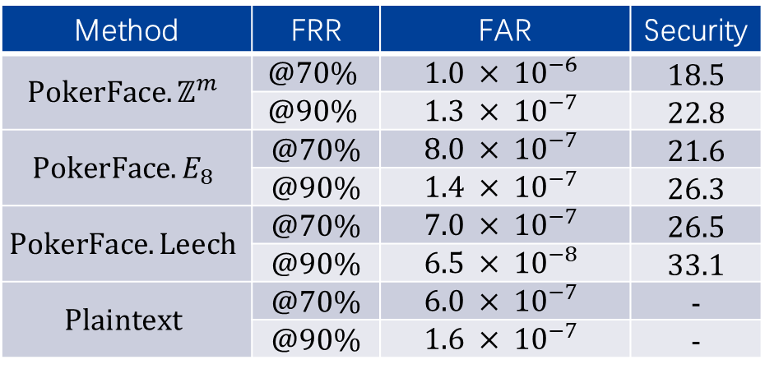
Results
Facial recognition offers more security than passwords.
Method | FRR | FAR | Security
$$PokerFace.ℤ^{m}$$ | $$@70\%$$ | $$1.0 × {10}^{−6}$$ | 18.5
 | $$@90\%$$ | $$1.3 × {10}^{−7}$$ | 22.8
$$PokerFace.E_{8}$$ | @70% | $$8.0 × {10}^{−7}$$ | 21.6
 | @90% | $$1.4 × {10}^{−7}$$ | 26.3
$$PokerFace.Leech$$ | @70% | $$7.0 × {10}^{−7}$$ | 26.5
 | @90% | $$6.5 × {10}^{−8}$$ | 33.1
$$Plaintext$$ | @70% | $$6.0 × {10}^{−7}$$ | -
 | @90% | $$1.6 × {10}^{−7}$$ | -
Password Dataset | Service | Policy | Security
RockYou | Social Games | 5+ | 15.9
LinkedIn | Social Network | 6+ | 19.1
000Webhost | Web Hosting | 6+ [a-Z][0-9] | 20.7
CSDN | Programmer forum | 8+ | 18.9
Dodonew | E-commerce&Games | None | 22.3

Slide 15
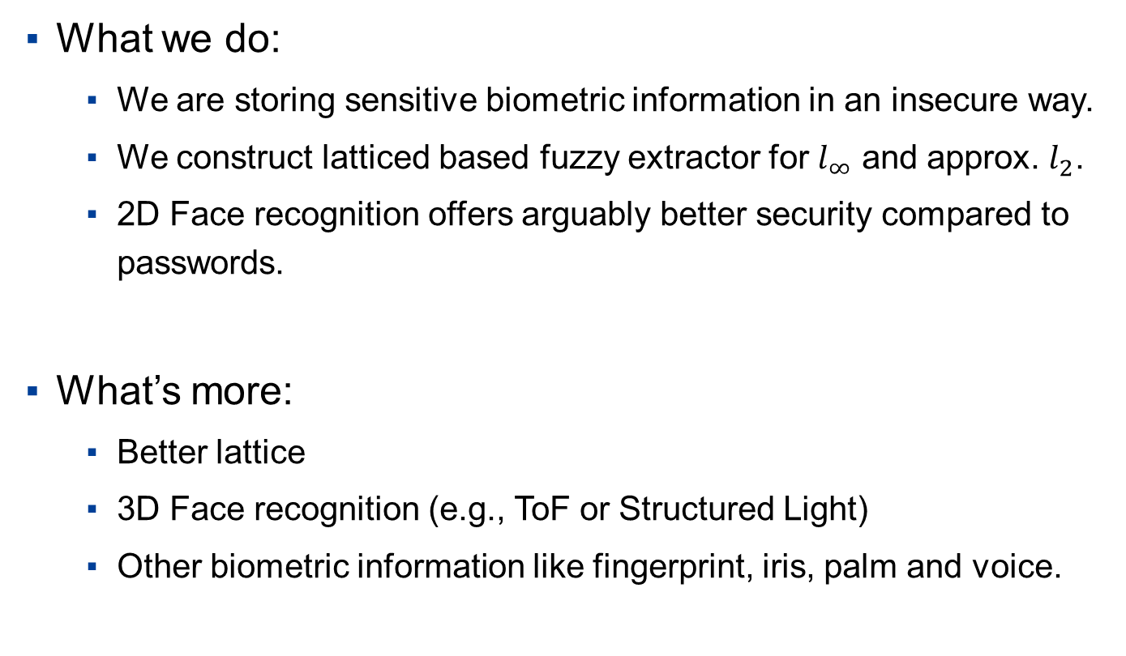
Conclusion
What we do:
We are storing sensitive biometric information in an insecure way.
We construct latticed based fuzzy extractor for $l_{∞}$ and approx. $l_{2}$.
2D Face recognition offers arguably better security compared to passwords.
What’s more:
Better lattice
3D Face recognition (e.g., ToF or Structured Light)
Other biometric information like fingerprint, iris, palm and voice.

Slide 16
THNKAS & QA

